Slide 1


DEPARTMENT OF COMPUTER SCIENCE AND ENGINEERING
PR0JECT PHASE II
REVIEW 3
Detection of Spinal Lumbar Stenosis Stages Classification by
CNN Techniques
PROJECT STUDENTS GUIDE
Kathi Prashanth, 41110601 Ms. T. Bhanushree M.E., (Ph.D)., Kathiravan K, 41110602 Assistant Professor, CSE
BATCH ID - 324

Slide 2
AGENDA
Abstract
Objective(s)
Literature Survey
Inferences from Literature Survey
Proposed System
Modules with Explanation
Hardware and Software Requirements, Datasets
Results and Discussion
Conclusion
References
Paper Publication Status(Presented/Published)

Slide 3
ABSTRACT
Spinal stenosis is a condition characterized by the narrowing of spaces within the spine, which can lead to pain, numbness, and muscle weakness. Accurate and timely diagnosis is crucial for effective treatment and management. In this study, we propose a deep learning-based approach for the classification of spinal stenosis disease. Leveraging advanced convolutional neural networks (CNNs), our model is trained on a comprehensive dataset of spinal imaging data, including MRI and CT scans. The proposed system aims to automatically detect and classify spinal stenosis with high accuracy, reducing the dependency on manual analysis by healthcare professionals.
Our approach includes data preprocessing techniques, model architecture design, and rigorous evaluation metrics to ensure robust performance. The experimental results demonstrate the potential of deep learning in enhancing diagnostic accuracy and efficiency in medical imaging for spinal stenosis, paving the way for improved patient outcomes and streamlined clinical workflows.
`

Slide 4
OBJECTIVE(S)
This study aims to implement Convolutional Neural Network (CNN) architectures for accurate and automated classification of spine stenosis in medical imaging.
The objective of detecting and classifying stages of spinal lumbar stenosis using Convolutional Neural Network (CNN) techniques is to enhance the accuracy and efficiency of diagnosis in this medical condition. Spinal lumbar stenosis is a prevalent disorder characterized by the narrowing of the spinal canal, often leading to debilitating symptoms. The application of CNNs in medical image analysis enables automated and precise recognition of specific patterns and features indicative of different stages of lumbar stenosis. This approach aims to provide clinicians with a reliable tool for early detection, classification, and personalized treatment planning, ultimately improving patient outcomes by facilitating timely interventions and reducing the risk of complications associated with this spinal disorder.

Slide 5
LITERATURE SURVEY(1/10)
S.No | Author(s) | Title | Year | Methodology | Inference | Merits | Demerits
1 | Fabio Galbusera, Gloria Casaroli, Tito Bassani | Artificial intelligence and machine learning in spine research | 2018 | Data Collection: Review existing literature on AI/ML in spine research.AI Techniques: Utilize models like CNNs for image analysis and supervised learning for diagnostics. Spine Applications: Focus on tasks such as vertebrae localization, segmentation, and outcome prediction.Ethical Review: Analyze issues of accountability, bias, and data privacy in AI. | Enhanced Accuracy: AI improves diagnostic precision and task repeatability in spine research. Ethical Challenges: Integration in clinical settings raises ethical questions, needing regulation. Future Prospects: AI could enable more personalized and efficient healthcare but requires advancements. | Consistency Time Efficiency, Predictive Insights, Decision Support. | Bias Risks, Accountability, Privacy Concerns, Validation Challenges

Slide 6
LITERATURE SURVEY(2/10)
S.No | Author(s) | Title | Year | Methodology | Inference | Merits | Demerits
2 | Amy Bellitto , Alice De Luca, Simona Gamba, Luca Losio, Antonino Massone, Maura Casadio , and Camilla Pierella | Clinical, Kinematic and Muscle Assessment of Bilateral Coordinated Upper-Limb Movements Following Cervical Spinal Cord Injury | 2023 | Functional Assessment: Combines clinical, kinematic, and muscle activity measures to assess bilateral arm movements in cSCI.Participant Groups: Twelve cSCI patients (C5-C7 lesions) and six unimpaired controls.Tests Administered: Manual Muscle Test, Range of Motion test, and Arm Stabilization Test (from Van Lieshout arm/hand function test).Data Analysis: Used muscle synergies, spinal maps, and Principal Component Analysis to interpret movement patterns and neuromotor changes. | Motor Limitations: Clinical tests showed restricted shoulder movement and impaired motor function in the elbows and wrists.Neuromotor Patterns: Analysis revealed abnormal activation of scapular stabilizers, latissimus dorsi, pectoralis, and triceps, contributing to movement difficulty. | Detailed Insight, Enhanced Assessment | Limited Sample Size, Complex Analysis

Slide 7
LITERATURE SURVEY(3/10)
S.No | Author(s) | Title | Year | Methodology | Inference | Merits | Demerits
3 | JunYoung Choi , Sang-Eun Lee , YeIn Lee, Eunji Cho , Sunghoe Chang , and Won-Ki Jeong | DXplorer: A Unified Visualization Framework for Interactive Dendritic Spine Analysis Using 3D Morphological Features | 2023 | DXplorer Framework: A 3D dendritic spine analysis system allowing interactive visualization and clustering of dendritic spines.3D Mesh-Based Analysis: High-dimensional morphological features extracted from a 3D mesh enable detailed analysis of spine structures.Interactive Machine Learning: Classifier integrates user feedback and visual exploration, enhancing classification accuracy for spine- phenotypes.User and Case Studies: Quantitative evaluations through user study and case studies to validate the system's performance and usability. | Enhanced Analysis: DXplorer offers accurate and objective dendritic spine morphology analysis, overcoming limitations of 2D approaches.Interactive Classification: User feedback integrated into machine learning improves precision in spine phenotype classification. | 3D Visualization, User-Friendly Interface | High Dimensionality, Learning Curve

Slide 8
LITERATURE SURVEY(4/10)
S.No | Author(s) | Title | Year | Methodology | Inference | Merits | Demerits
4 | Md. Raihan-Al-MasudID, M. Rubaiyat Hossain MondalID | Data-driven diagnosis of spinal abnormalities using feature selection and machine learning algorithms | 2020 | Feature Selection: Utilized univariate feature selection (filter method) and Principal Component Analysis (PCA) for feature extraction.Machine Learning Models: Applied support vector machine (SVM), logistic regression (LR), and bagging ensemble methods (bagging SVM and bagging LR).Dataset: Used a Kaggle dataset of 310 samples with a train-test split of 78% training data.Evaluation Metrics: Assessed models on training/testing accuracy, recall, miss rate, ROC, and precision-recall curves. | Model Performance: All models achieved similar test accuracy (86.96%), but bagging SVM had superior recall and lower miss rate.Best Model: Bagging SVM emerged as the preferred model for spinal abnormality classification due to its accuracy and reliability in recall. | Enhanced Accuracy, Comprehensive Evaluation, Feature Reduction | Data Limitations, Computational Complexity

Slide 9
LITERATURE SURVEY(5/10)
S.No | Author(s) | Title | Year | Methodology | Inference | Merits | Demerits
5 | PeiYang Wang, MD1 , Wei Zhang, MS1 , Yong Huang, MD1 , YunTao Wang, PhD3 , and XiaoTao Wu, MD | Current Applications of Machine Learning in Spine: From Clinical View | 2020 | Literature Review: Conducted a comprehensive PubMed search (2006–2020) focusing on ML applications in the spine domain.Article Screening: Screened 1738 articles, ultimately including 292 studies after excluding irrelevant or incomplete research.Focus Areas: Summarized findings on ML applications in imaging, diagnostics, decision support, operative assistance, rehabilitation, outcomes, complications, and healthcare costs.

Slide 10
LITERATURE SURVEY(6/10)
S.No | Author(s) | Title | Year | Methodology | Inference | Merits | Demerits
6 | Jyoti Waykule1 , Swaliha Maindergi2 , Prajkta Patil3 , Pramodini Kanase4 | Spine Diseases Detection Using Image Processing. | 2020 | Image Processing Tools: Utilizes MATLAB’s Image Processing Toolbox for reading, processing, visualizing, and saving images.Feature Extraction: Applies Histogram of Oriented Gradients (HOG) to extract image features.Classification Model: Uses Support Vector Machine (SVM) for boundary regression in biomedical image segmentation. | Spine Disease Detection: HOG and SVM, combined with MATLAB processing tools, are effective for segmenting and identifying features relevant to spine disease diagnosis. | Efficient Feature Extraction Automation Potential | Tool Dependency, Limited Scope

Slide 11
LITERATURE SURVEY(7/10)
S.No | Author(s) | Title | Year | Methodology | Inference | Merits | Demerits
7 | Swansea | Spinal tumours | 2022 | clinical research, observational studies, or case analyses focused on the types of spinal tumours and their origins.Research methods might include diagnostic imaging, biopsy analysis, or longitudinal studies tracking patients with spinal tumours to understand their progression and origins (primary vs. metastatic). | Primary spinal tumours do not yet have a known cause, nor is there a clear reason why some are malignant and others are not.Secondary spinal tumours are always the result of metastasis from another cancerous tumour in the body. | Clarity of distinction, current gap in knowledge, brief and concise | specific research methods, mechanisms or potential factors, absence of context or evidence

Slide 12
LITERATURE SURVEY(8/10)
S.No | Author(s) | Title | Year | Methodology | Inference | Merits | Demerits
8 | James gosling | Artificial Intelligence in Spinal Imaging and Patient Care: A Review of Recent Advances | 2024 | Clinical task-based evaluation of AI in spinal imaging, focusing on image enhancement, quantification, pathology detection, and surgical planning. | AI improves diagnostic accuracy, aids in surgical planning, and enables personalized treatment predictions, but faces challenges in model interpretability and data limitations. | Enhances image quality, facilitates expert-level diagnosis, and supports personalized treatment and surgical planning. | Challenges with AI model interpretability, generalizability, and data limitations, hindering clinical adoption.

Slide 13
LITERATURE SURVEY(9/10)
S.No | Author(s) | Title | Year | Methodology | Inference | Merits | Demerits
9 | Wei Yi1 · Jingwei Zhao2 · Wen Tang3 · Hongkun Yin3 · Lifeng Yu4 · Yaohui Wang5 · Wei Tian | Deep learning‑based high‑accuracy detection for lumbar and cervical degenerative disease on T2‑weighted MR images | 2023 | Retrospective study using T2-weighted MRI scans from 804 patients to develop and validate a deep learning model (3D ResNet18 with transformer architecture) for detecting lumbar degenerative disease. The model's generalized performance was evaluated using cervical MRI scans (200 patients) from an independent hospital. | The DL model effectively detects lumbar and cervical degenerative diseases using T2-weighted MRI and demonstrates strong diagnostic performance in both internal and external datasets, validated through fROC and precision-recall curves. | High accuracy, multiple datasets, Generalizability, Provides reliable performance metrics such as precision, recall, and F1-score. | T2-weighted MRI scans, Data dependency

Slide 14
LITERATURE SURVEY(10/10)
S.No | Author(s) | Title | Year | Methodology | Inference | Merits | Demerits
10 | Margaret holler | Spinal cord tumpors | 2022 | Retrospective study using T2-weighted MRI scans from 804 patients with lumbar degenerative disease to develop and validate a deep learning model (3D ResNet18 with transformer architecture).The model was trained with a training dataset (456 patients) and validated using internal (134 patients) and external datasets (100 and 114 patients).Generalized performance was tested with cervical MR images (200 patients). | The DL model effectively detects lumbar and cervical degenerative diseases, showing strong diagnostic performance, evaluated by fROC and precision-recall curves. | High accuracy, multiple datasets ensuring better generalizability, Provides comprehensive performance metrics (precision, recall, F1-score). | Dependent on T2-weighted MRI scans, Data quality and diversity.

Slide 15
INFERENCES FROM LITERATURE SURVEY
Lack of Deployment Process:
The existing system does not implement a comprehensive deployment process, which limits its practical application in clinical settings and hinders accessibility for healthcare professionals.
Simplicity of Methods:
The current methods employed are relatively simple and do not utilize advanced techniques such as Convolutional Neural Networks (CNNs) or Artificial Neural Networks (ANNs), which could enhance diagnostic accuracy and efficiency.
Insufficient Image Preprocessing:
The existing system fails to incorporate essential image preprocessing steps, such as normalization and augmentation, which are critical for improving the quality of input data and the overall performance of diagnostic models.
Limited Data Analysis:
There is a lack of comprehensive data analysis processes, including the use of plots and graphs, which are necessary for visualizing results and understanding the performance of the diagnostic system. This limits the ability to derive meaningful insights from the data.

Slide 16
PROPOSED SYSTEM
The proposed system for the detection and classification of spinal lumbar stenosis stages utilizes advanced Convolutional Neural Network (CNN) techniques to enhance diagnostic accuracy and streamline patient care. Leveraging the power of deep learning, this innovative approach aims to categorize different stages of lumbar stenosis with a high degree of precision, providing healthcare professionals with valuable insights for tailored treatment plans. The CNN architecture employed in this system is designed to analyze medical imaging data, such as MRIs and CT scans, allowing for automated and efficient identification of lumbar stenosis severity. By harnessing the capabilities of neural networks, the proposed system contributes to a more nuanced understanding of spinal health, facilitating early intervention and personalized medical interventions. This technology represents a significant stride toward improving diagnostic capabilities in the field of orthopedics, ultimately enhancing patient outcomes and quality of care.

Slide 17
PROPOSED SYSTEM(1/5)
Advantages of Proposed System
Superior Diagnostic Precision:
The advanced Convolutional Neural Network (CNN) techniques employed in the system provide a high level of accuracy in detecting and classifying various stages of spinal lumbar stenosis, minimizing the risk of misdiagnosis.
Efficiency through Automation:
By automating the analysis of medical imaging data, the system significantly reduces the time required for diagnosis, allowing healthcare professionals to focus on patient care rather than manual image interpretation.
Personalized Treatment Strategies:
The system's ability to categorize stenosis severity enables healthcare providers to create tailored treatment plans that address the specific needs of each patient, improving the effectiveness of interventions.
Early Detection and Intervention:
The precise classification of spinal conditions facilitates early detection, allowing for timely medical interventions that can prevent the progression of the disease and enhance patient outcomes.
Improved Patient Outcomes:
By streamlining the diagnostic process and enabling personalized care, the proposed system ultimately leads to better health outcomes for patients, enhancing their quality of life and reducing the burden of spinal disorders.

Slide 18
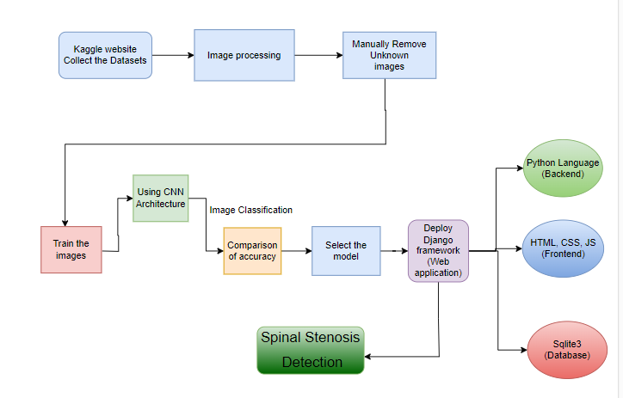
PROPOSED SYSTEM(2/5)
System Architecture

Slide 19
PROPOSED SYSTEM(3/5)
MODULES EMPLOYED
MANUAL NET
GOOGLE NET
LENET
RESNET

Slide 20
GOOGLE NET
"GoogleNet," also known as "Inception-v1," is a deep learning architecture for image classification. It was developed by a team of researchers at Google, led by Christian Szegedy, and was the winner of the ImageNet Large Scale Visual Recognition Challenge (ILSVRC) in 2014.
The main innovation in the GoogleNet architecture is the use of the "Inception module," which incorporates multiple parallel convolutional operations of different filter sizes to capture features at various scales. This allows the network to learn both fine-grained and high-level abstract features efficiently.
Key features of the GoogleNet architecture:
Inception Module: The Inception module consists of a combination of 1x1, 3x3, and 5x5 convolutional filters, along with max-pooling operations. The idea behind this module is to allow the network to learn features at different spatial scales and capture both local and global patterns effectively. Additionally, 1x1 convolutions are used to reduce the dimensionality of the input channels, which helps in reducing computational complexity.
Multiple Stacked Inception Modules: GoogleNet consists of multiple stacked Inception modules to create a deep network. These modules are designed to capture increasingly complex patterns as the network goes deeper. The inclusion of multiple Inception modules also allows the network to be computationally efficient, as it can utilize different filter sizes simultaneously.
Auxiliary Classifiers: GoogleNet includes auxiliary classifiers at intermediate layers of the network. These auxiliary classifiers serve as "side branches" and are used to combat the vanishing gradient problem during training. They add extra supervision to the network and help in better gradient flow during backpropagation

Slide 21
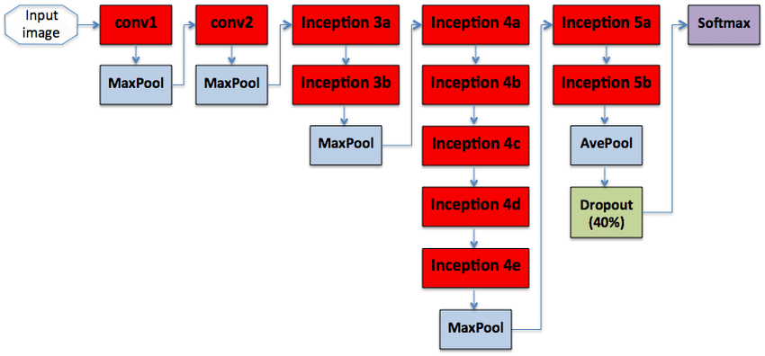

Slide 22
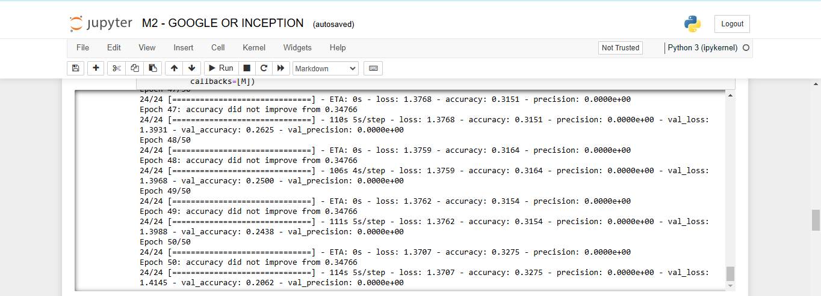
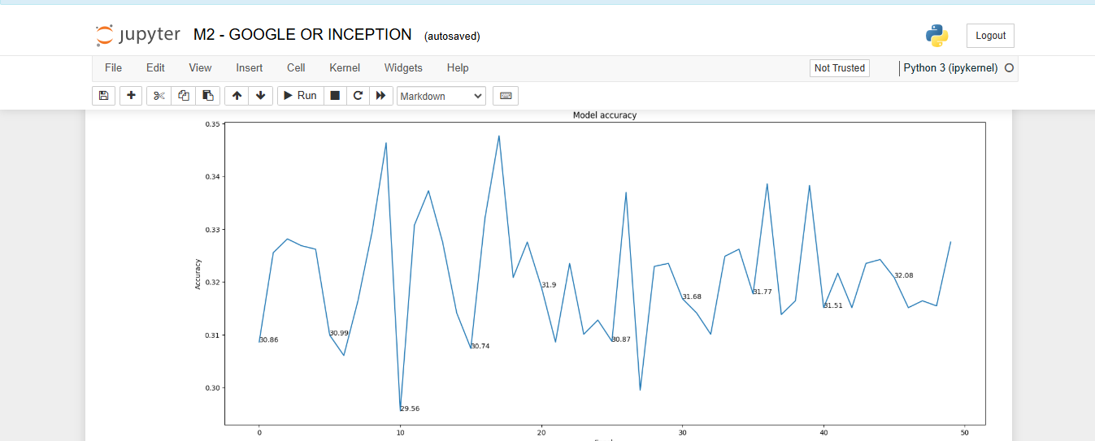

Slide 23
LENET
The LeNet architecture is a pioneering convolutional neural network (CNN) architecture developed by Yann LeCun and his colleagues in the early 1990s. It played a crucial role in the advancement of deep learning and was specifically designed for handwritten digit recognition tasks, such as recognizing digits in checks and postal addresses. LeNet laid the foundation for modern CNNs and their applications in image recognition and computer vision tasks.
The LeNet architecture consists of the following layers:
Input Layer: This layer accepts the input image, which is typically a grayscale image of a handwritten digit. The input images are usually of size 32x32 pixels.
Convolutional Layers: LeNet uses two convolutional layers to extract features from the input images. Each convolutional layer applies convolutional filters (also called kernels) to the input image, capturing different patterns and features. These filters slide over the image to create feature maps.
Subsampling (Pooling) Layers: After each convolutional layer, a subsampling layer (also known as a pooling layer) is applied to reduce the spatial dimensions of the feature maps and help in retaining important information while reducing computation.
Fully Connected Layers: The subsampled feature maps are then flattened and passed through fully connected layers, which are traditional neural network layers. These layers are responsible for making classification decisions based on the extracted features.
Output Layer: The final fully connected layer produces the output of the network, which represents the predicted class probabilities. For handwritten digit recognition, this would typically involve 10 output nodes, each corresponding to a digit class (0 to 9).

Slide 24
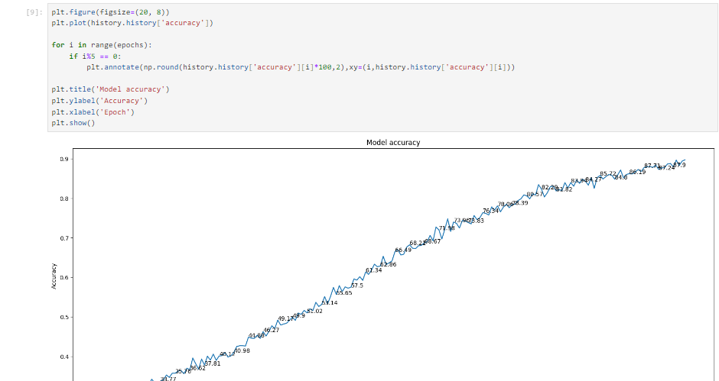
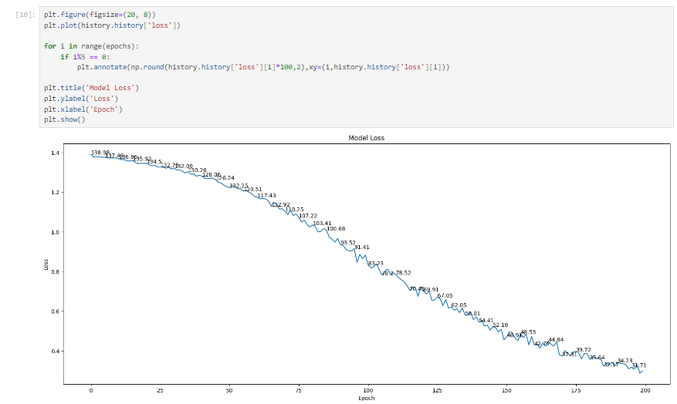

Slide 25
RESNET
ResNet (Residual Network) is a deep learning architecture introduced by Kaiming He and colleagues in 2015 to address the challenges of training very deep neural networks, particularly the vanishing gradient problem. The key innovation in ResNet is the introduction of residual learning through shortcut connections, which allow the network to learn residual mappings instead of the full target function. By adding the input directly to the output of a block, gradients can flow more effectively through the network, making it easier to train even with hundreds of layers.
The core component of ResNet is the residual block, which consists of convolutional layers and a skip connection that bypasses one or more layers. For networks with matching input and output dimensions, the shortcut is a simple identity mapping; otherwise, it uses a 1×11 \times 11×1 convolution for dimensional alignment. ResNet's ability to train very deep networks without performance degradation led to the development of multiple variants, including ResNet-18, ResNet-34, ResNet-50, and ResNet-101, where the numbers represent the total layers. Deeper versions like ResNet-50 use a bottleneck design to improve computational efficiency.
ResNet has become a foundational architecture in computer vision, powering applications such as image classification, object detection, and semantic segmentation. Its pre-trained models are widely used for transfer learning in various domains. The architecture's success has inspired other innovations like DenseNet and EfficientNet, reinforcing ResNet's role as a landmark in deep learning research.

Slide 26
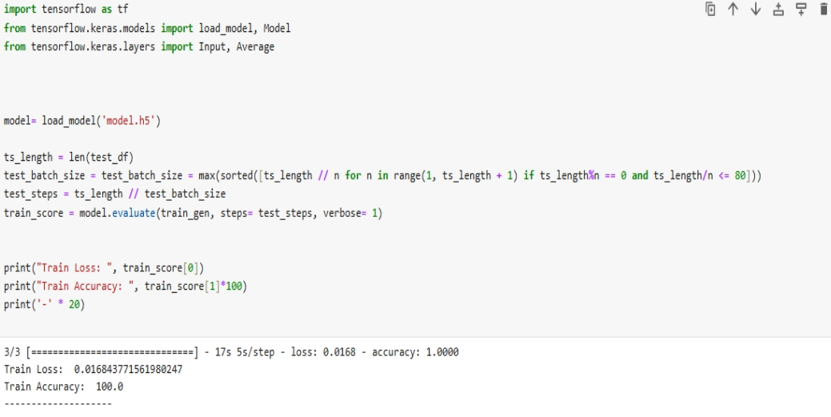

Slide 27
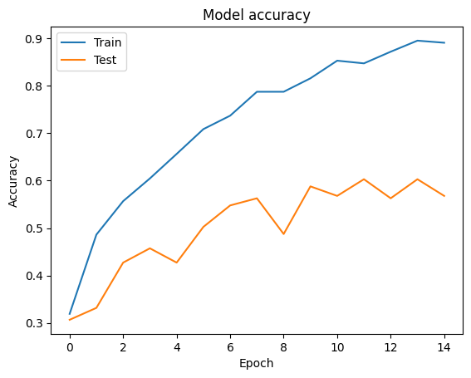
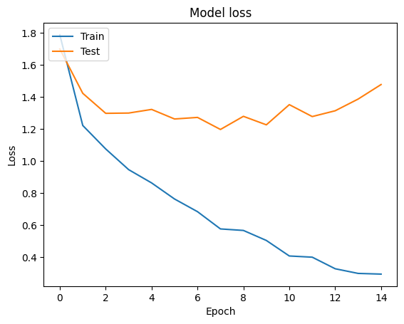
ACCURACY

Slide 28
Hardware and Software Requirements, Datasets
OPERATING SYSTEM: Windows 10 or Higher: A stable and widely supported operating system to ensure compatibility with various software applications and hardware components.
HARDWARE SPECIFICATIONS
1. Processor: Intel Core i7 or equivalent, with multiple cores to handle parallel processing tasks efficiently.
2. Memory (RAM): At least 16 GB to support the demands of deep learning model training and inference.
3. Storage (ROM): A minimum of 1 TB SSD to accommodate large datasets and ensure fast data retrieval and system responsiveness.
4. Graphics Processing Unit (GPU): NVIDIA GeForce RTX series or equivalent with CUDA support to accelerate deep learning computations.
SOFTWARE REQUIREMENTS
1. Programming Language: Python 3.8 or higher, due to its extensive libraries and frameworks suitable for machine learning and deep learning applications and Anaconda Navigator.
2. Development Environment: Visual Studio Code (VS Code) or PyCharm for code development and debugging.
3. Deep Learning Frameworks: TensorFlow and PyTorch for building and deploying neural network models.
4. Image Processing Libraries: OpenCV and scikit-image for preprocessing and analyzing medical images.
Additional Tools:
Database Management System: MySQL or PostgreSQL for storing patient data and analysis results securely.
Version Control System: Git for tracking changes in the codebase and facilitating collaborative development.

Slide 29
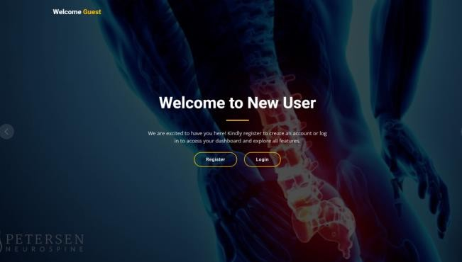
RESULTS AND DISCUSSION(1/5)
SCREEN SHOTS: WELCOME PAGE

Slide 30
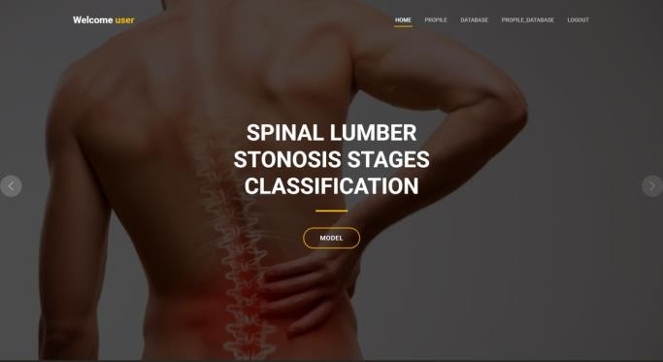
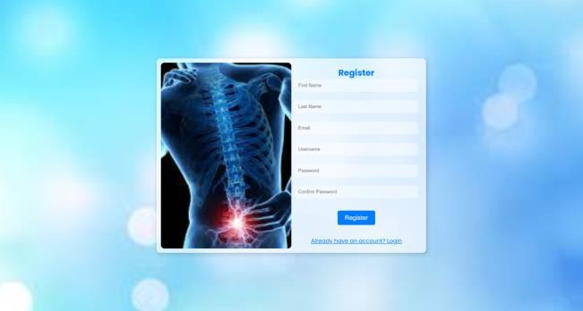
RESULTS AND DISCUSSION(2/5)
LOGIN PAGE
REGISTRATION PAGE

Slide 31
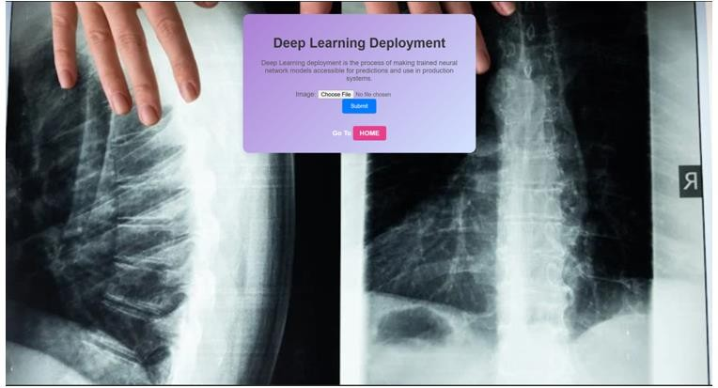
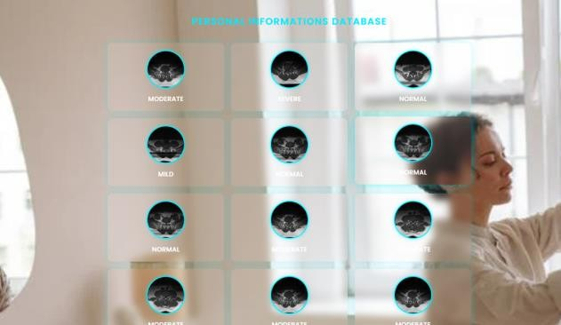
RESULTS AND DISCUSSION(3/5)
DATA INPUT PAGE
DATABASE PAGE

Slide 32
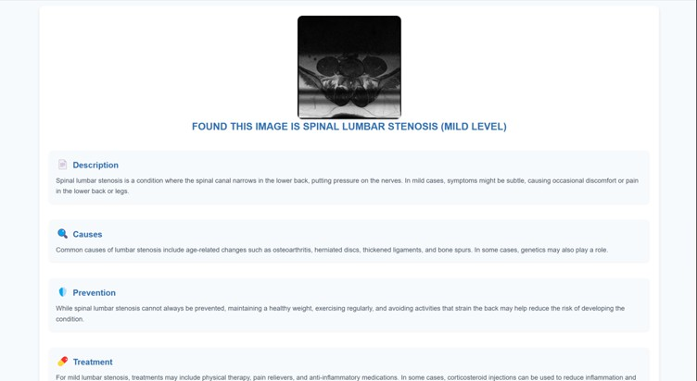
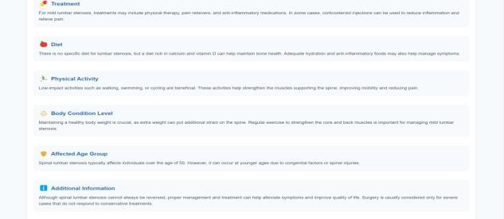
RESULT PAGE

Slide 33
RESULTS AND DISCUSSION(4/5)
5.1 GOOGLE NET
Model Overview:
The GoogleNet architecture incorporates inception modules that facilitate deeper convolutional networks while maintaining computational efficiency.
Key Findings:
The model showed fluctuations in accuracy throughout the epochs, indicating the model's learning capability and possibly overfitting.
The training loss decreased consistently, suggesting effective learning.

Slide 34
RESULTS AND DISCUSSION(5/5)
5.2 LENET
Model Overview:
The LeNet architecture consists of convolutional layers followed by subsampling and a fully connected layer terminal.
Key Findings:
Achieved high training accuracy and low loss values.
Effects of data augmentation was observed, improving model generalization on unseen data.

Slide 35
5.3 RESNET
Model Overview:
ResNet utilizes residual learning frameworks to facilitate the training of deeper networks.
Key Findings:
Demonstrated superior accuracy compared to both LeNet and Google Net. Stability in loss reduction over epochs indicates better training convergence.
The results reveal the effectiveness of modern convolutional architectures, particularly ResNet, in achieving high accuracy while minimizing loss during training. Further investigations could explore fine-tuning and additional data augmentation techniques to enhance generalization capabilities across various datasets.

Slide 36
CONCLUSION
In conclusion, the application of Convolutional Neural Network (CNN) architectures in SPINE STENOSIS classification has demonstrated significant strides towards improving diagnostic accuracy in musculoskeletal radiology. The robust feature extraction capabilities of CNNs have enabled the identification and categorization of diverse spine abnormalities with remarkable precision. This technological advancement holds promise for streamlining and enhancing the efficiency of diagnostic processes, ultimately contributing to more inform clinical decision-making. As the field continues to embrace automated image analysis, the integration of CNN architectures stands out as a pivotal step towards revolutionizing spine diagnostics and improving patient outcomes. Further research and refinement of these models promise continued advancements in the realm of automated musculoskeletal imaging analysis.
Future Work:
Medical department wants to automate the detecting of SPINE STENOSIS from eligibility process (real time).
To optimize the work to implement in cloud environment.

Slide 37
Reference
Campagner A, Berjano P, Lamartina C, Langella F, Lombardi G, Cabitza F. Assessment and prediction of spine surgery invasiveness with machine learning techniques. Comput Biol Med. 2020; 121:103796. doi:10.1016/j.compbiomed.2020.103796
​G. J. Snoek, M. J. I. Jzerman, H. J. Hermens, D. Maxwell, and F. Biering-Sorensen, “Survey of the needs of patients with spinal cord injury: Impact and priority for improvement in hand function in tetraplegics,” Spinal Cord, vol. 42, no. 9, pp. 526–532, Sep. 2004, doi: 10.1038/sj.sc.3101638.
​He K, Zhang X, Ren S, Sun J. Deep residual learning for image recognition. Proceedings of the IEEE Conference on Computer Vision and Pattern Recognition; Piscataway, NJ: Institute of Electrical and Electronics Engineers (IEEE); 2016. ArXiv Preprint arXiv:1512.03385.
​L. Britten, R. O. Coats, R. M. Ichiyama, W. Raza, F. Jamil, and S. L. Astill, “The effect of task symmetry on bimanual reach-to-grasp movements after cervical spinal cord injury,” Exp. Brain Res., vol. 236, no. 11, pp. 3101–3111, Nov. 2018, doi: 10.1007/s00221-018-5354-8.​
L. Reissner, G. Fischer, R. List, W. R. Taylor, P. Giovanoli, and M. Calcagni, “Minimal detectable difference of the finger and wrist range of motion: Comparison of goniometry and 3D motion analysis,” J. Orthopaedic Surgery Res., vol. 14, no. 1, p. 173, Jun. 2019, doi: 10.1186/s13018-019-1177-y.
​Manchikanti L, Singh V, Frank JEF, Benyamin RM, Hirsch JA. Epidemiology of low back pain in adults. Neuromodulation. 2014; 17(S2): 3–10. https://doi.org/10.1111/ner.12018 PMID: 25395111
​Nijeweme–d WO, Velsen LV, Groothuis OKGM, Soer R, Hermens H. Should I see a healthcare professional or can I perform self-care: self-referral decision support for patients with low back pain. IEEE International Conference on Healthcare Informatics (ICHI). 2016: 495–503. https://doi.org/10.1109/ ICHI.2016.90
​Scheer JK, Smith JS, Schwab F, et al. Development of a preoperative predictive model for major complications following adult spinal deformity surgery. J Neurosurg Spine. 2017;26:736-743.​
Wirries A, Geiger F, Hammad A, Oberkircher L, Blu¨mcke I, Jabari S. Artificial intelligence facilitates decision-making in the treatment of lumbar disc herniations. Eur Spine J.2020. doi:10.1007/s00586-020-06613-2
​Yin P, Mao N, Zhao C, Wu J, Chen L, Hong N. A tripleclassification radiomics model for the differentiation of primary chordoma, giant cell tumor, and metastatic tumor of sacrum based on T2-weighted and contrast-enhanced T1-weighted MRI. JMagn Reson Imag. 2019;49(3):752-759. doi:10.1002/jmri.26238

Slide 38
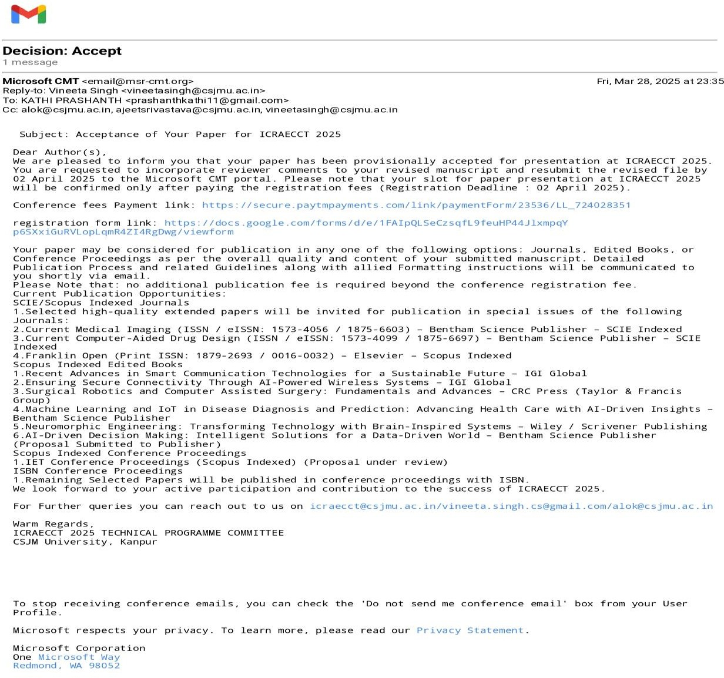
Paper Publication Status(Presented/Published)
International Conference on Recent Advances in Emerging Computing and Communication Technologies (ICRAECCT) - 2025 Hybrid Mode

Slide 39

PAYMENT PROOF SCREENSHOT

Slide 40
THANK YOU
We thank God, Our Department, Guide, Panel Members, Supportive Professors and all Technical and non Technical staff who helped us in our Project.

